Slide 1


Slide 2
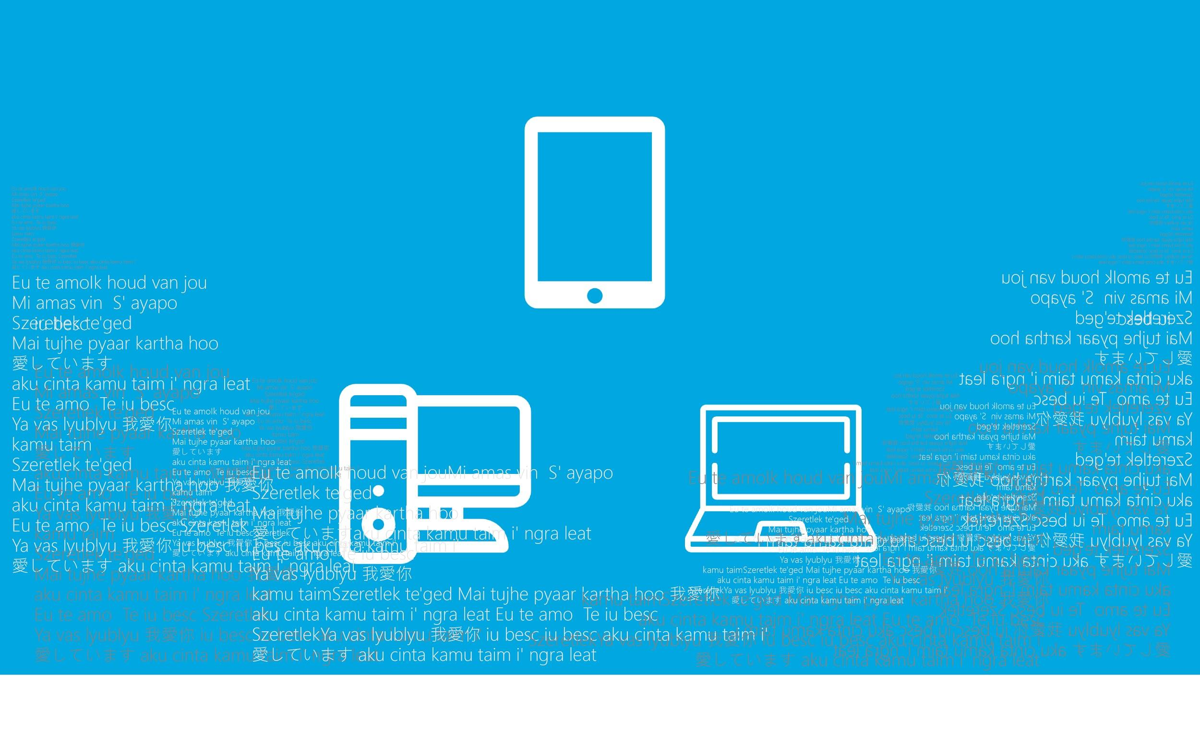

Slide 3


Slide 4

300,000,000

Slide 5
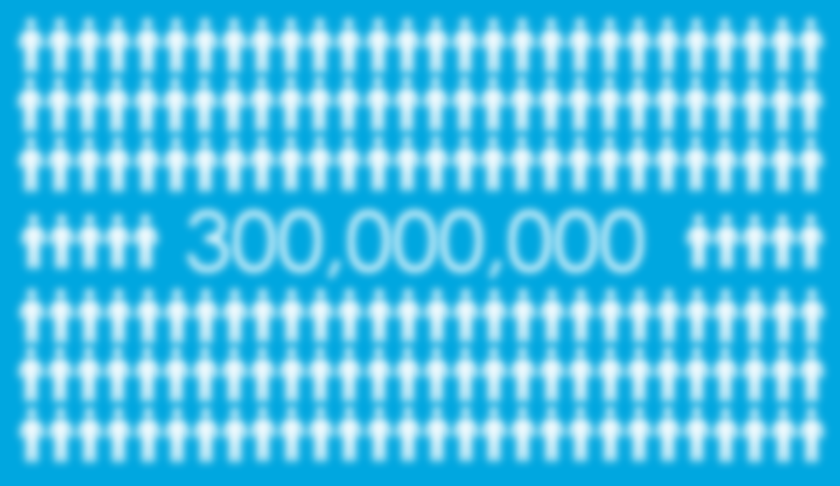


Notes:
白色方塊要半透明

Slide 6
Notes:
白色方塊要半透明

Slide 7

Notes:
白色方塊要半透明

Slide 8
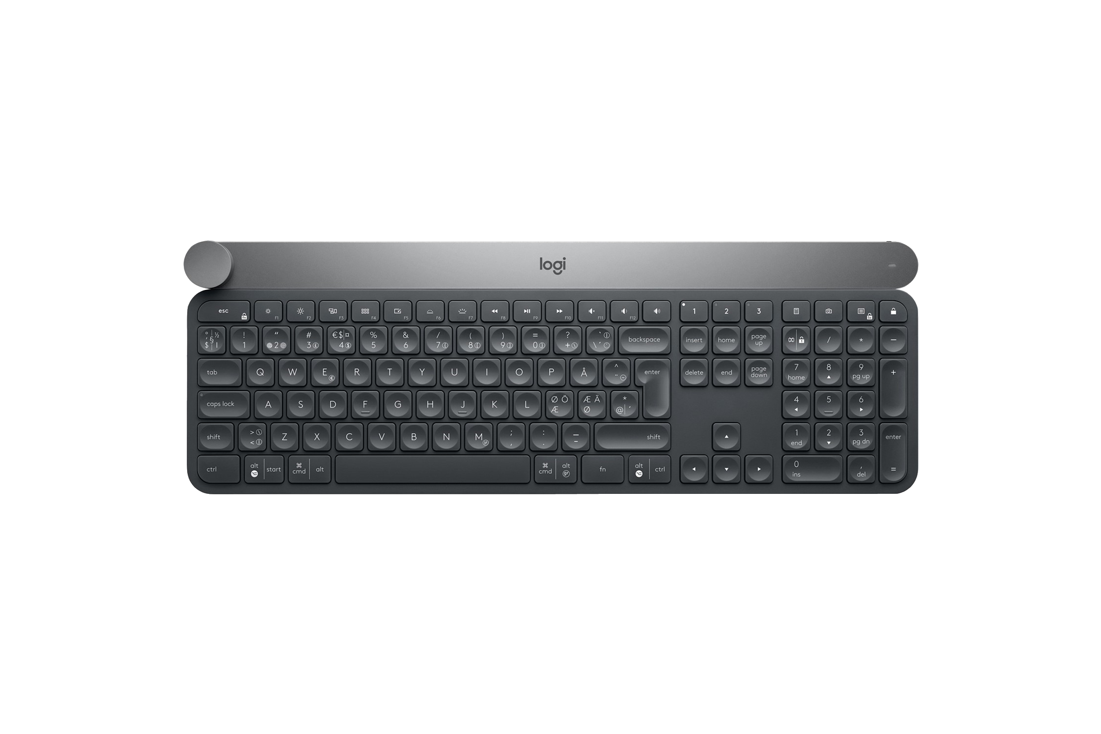

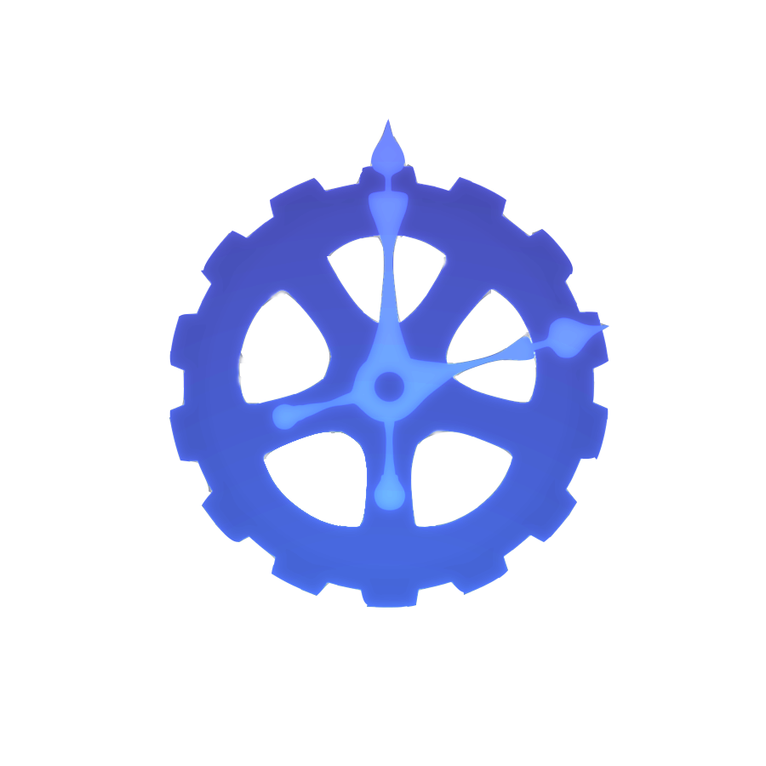

Lighten Bridge
A straightforward tool that helps blind people to read and do translations
Team : Majestic Cliff Hatters KJEM
Company group : Logitech
27.10.2018
M.L., wu, Institute of Communications Eng.
S.Z., Tseng, Institute of Biomedical Eng.
C.L., Lu, Institute of Electrical and Control Eng.
A. Y., lLn, Institute of Communications Eng.

Slide 9
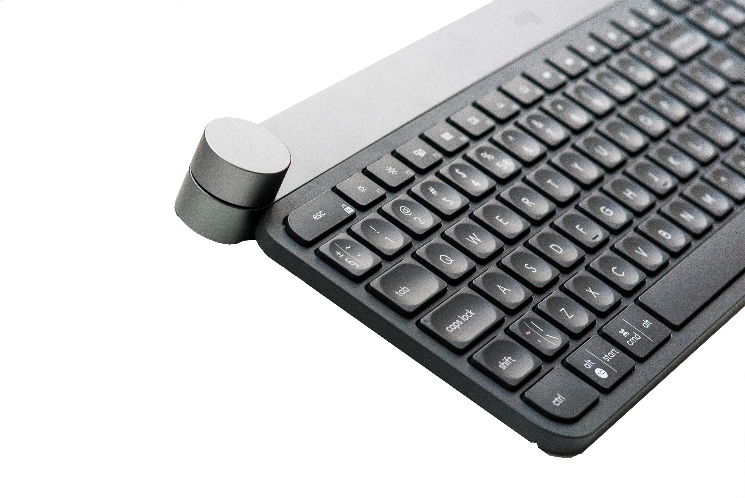
AGENDA
1. Problems of reading foreign languages
- User goals and Usability goals
- User scenarios
2. How can “Craft” help us
-craft and Lighten Bridge
-User tasks and demo
3. Our future plan

Slide 10
ONE
Problems of blinds reading
foreign languages

Slide 11

User goals and Usability goal
problem of blinds and essay
For most of us, reading foreign languages is not difficult anymore, but it’s still a challenge for blind people to read from an unfamiliar language.
“I wonder if I could understand the meaning of
many master pieces in other language which I can’t understand.”

Slide 12
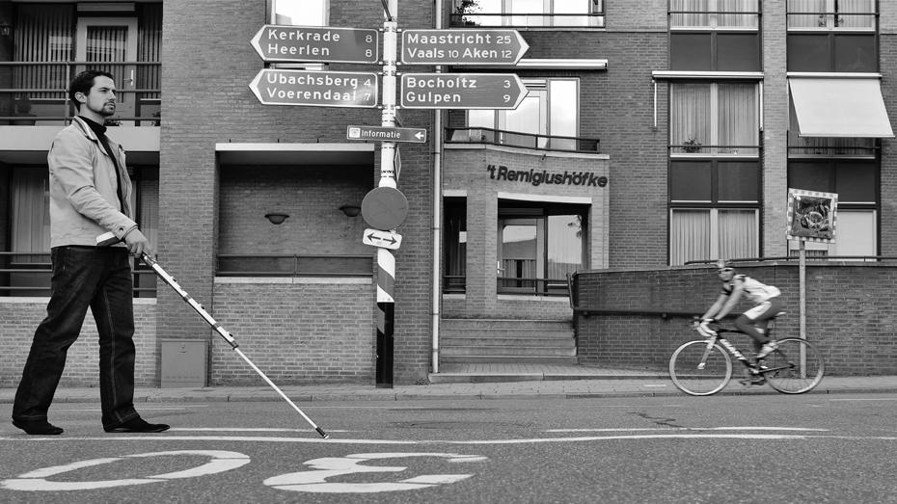
User scenarios
Problem of blinds and essay
Gang, Wang (25)
In my childhood, I like to read fiction in english very much.
But after the accident, everything changes. I could not keep my hobby anymore, because text translation is a lot more difficult for blinds. Although there are some reading tools for blinds, but they are only in native language. I must translate each word individually, but most of the times I can’t even find the word in such a large article again and again.

Slide 13

Thus our primary goal is :
To provide blind people an easy and intuitive way to translate digital articles.

Slide 14
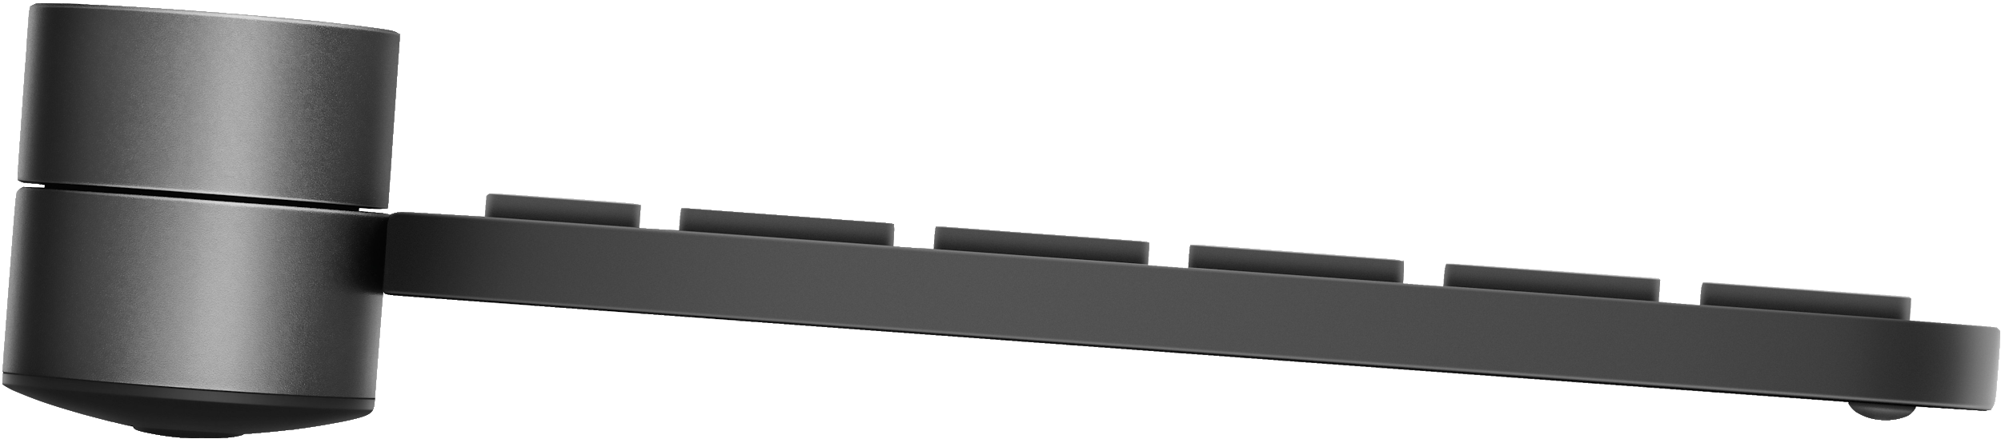
Two
How can “Craft” help us

Slide 15
Craft and Lighten Bridge
How can “Craft” help us
The “Craft keyboard” from logi provides an intuitive linear operation.
The feature allows users to select their desire section easily without looking at it.
Notes:
https://youtu.be/lXMJt5PP3kM?t=12m43s

Slide 16
And this is our
Lighten Bridge

Slide 17

User tasks
reading function
pause / play : tap.
translation function
translate single vocabulary :
select : turn.
translate : tap.
translate sentence :
upper_select : tap_shift.
cursor_move : turn.
lower_select : tap_shift.
personal setting function
voice_speed : turn.
voice_volumn : turn.
voice_feature : turn.
langauge : turn.
interval_switch : tap_shif.
function switch : touch_shift.
weak_up : touch.
How can “Craft” help us
After our “Usability Evaluation test”, we review our original UX design and modify it into the best condition.
reading original article
pause/play
Reading function
translate one of the vocabulary/
translate sentence
setting voice
speed / volumn / type / language
Translation function
Personal setting function

Slide 18
Concept video
How can “Craft” help us

Slide 19
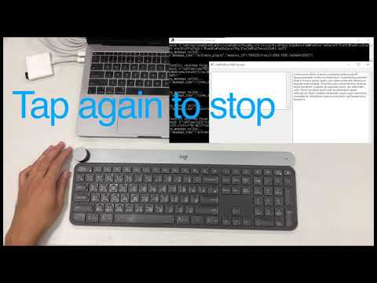
Notes:
影片放的地方

Slide 20
Three
Our future plan

Slide 21

Our future plan
In the future, we hope to develope Googel Chrome plugins
to make foreign-language website surfing a lot more easier than before for blind people.

Slide 22
Lighten Bridge
construct the bridge between the dark and the universe

Slide 23
104 28 18 12號字

